Slide 1
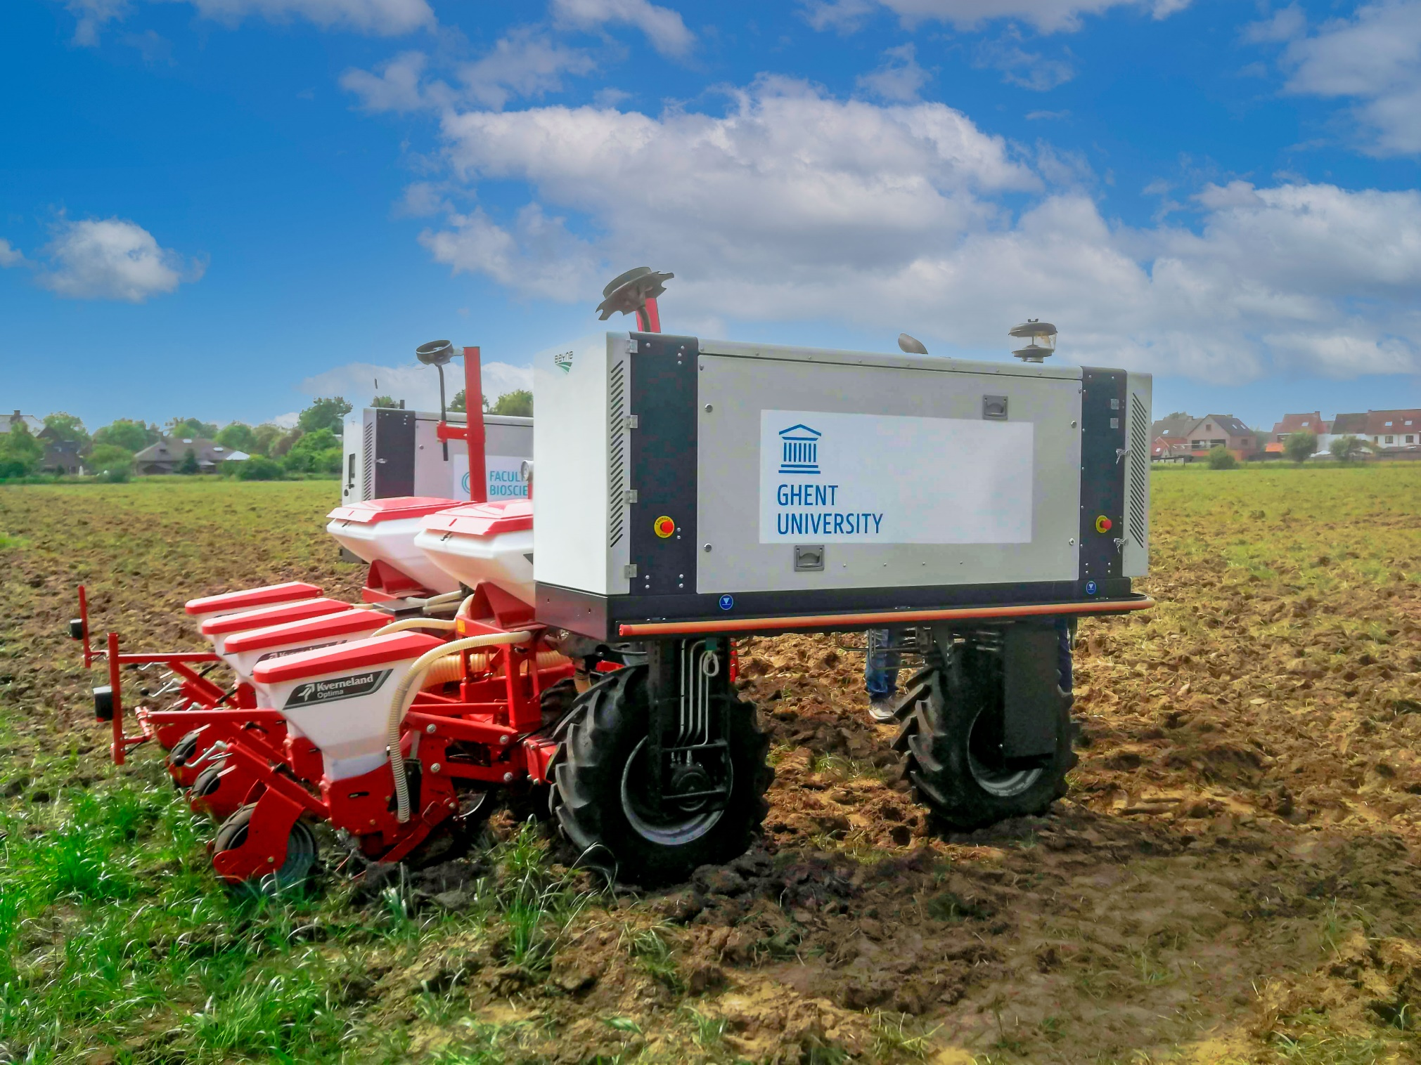

MULTIFUNCTIONELE
LANDBOUWROBOT
Voorstelling 8/9/2021

Slide 2


Slide 3
Prof. MARC VAN MEIRVENNE
Decaan faculteit Bio-ingenieurswetenschappen UGent

Slide 4
Hilde Crevits
Viceminister-president en Vlaams minister van Economie, Innovatie, Werk, Sociale Economie en Landbouw

Slide 5
Prof. Geert haesaert
Proefhoeve UGent-HOGENT

Slide 6
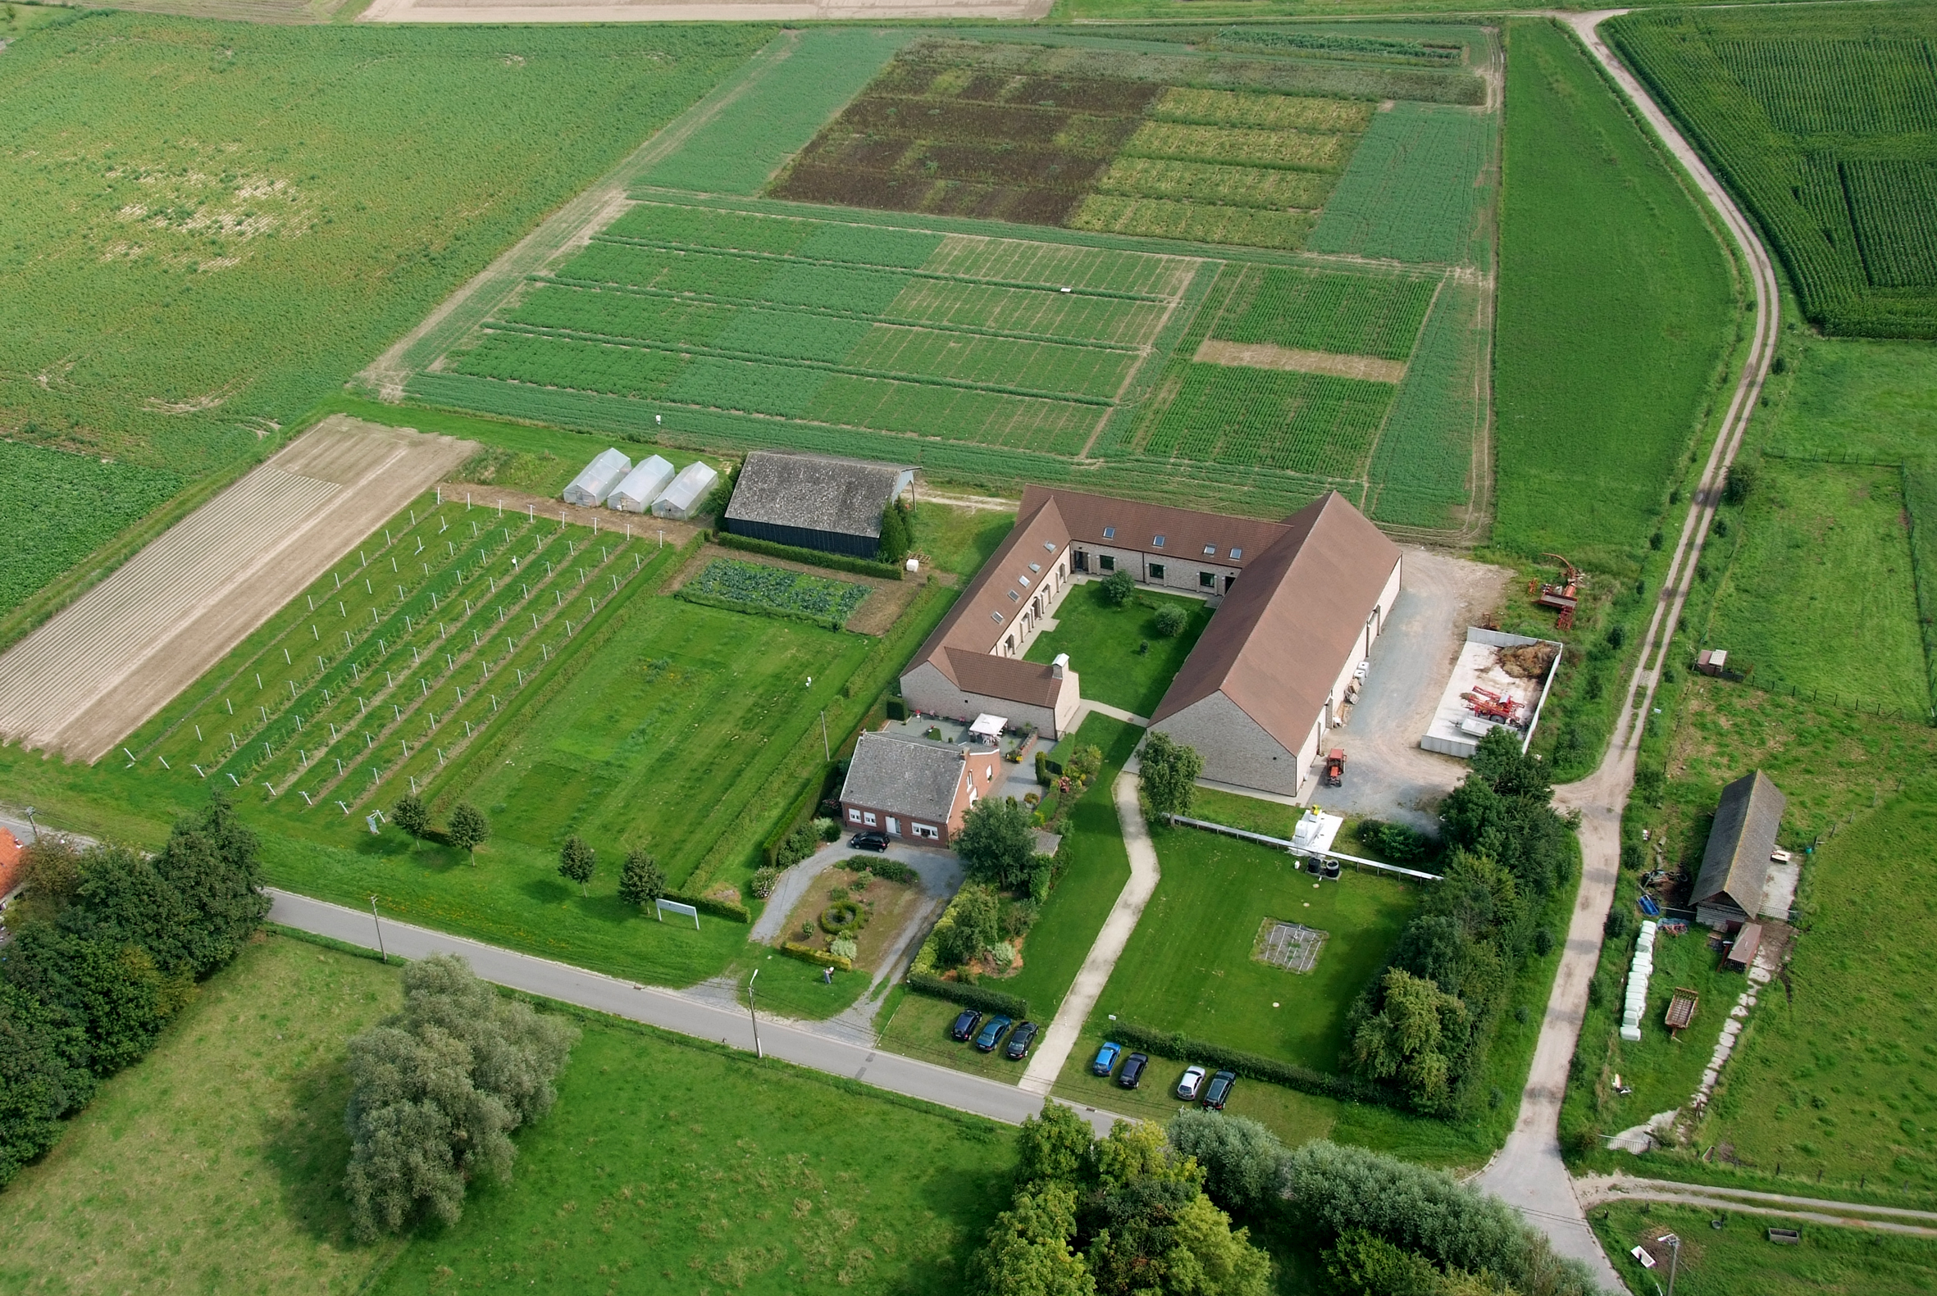



Research station
Bottelare
Proefhoeve
Bottelare
SCIENCE AND
TECHNOLOGY

Slide 7
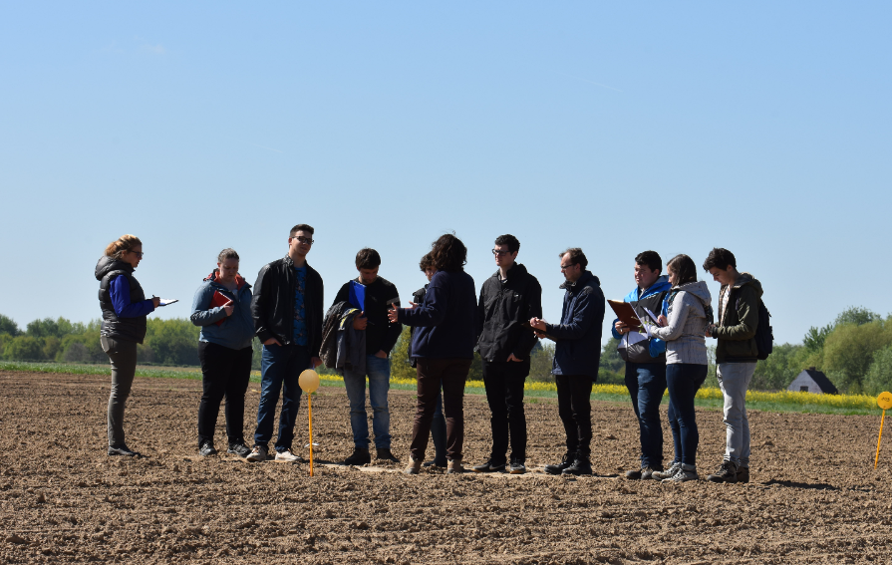
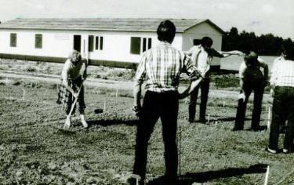
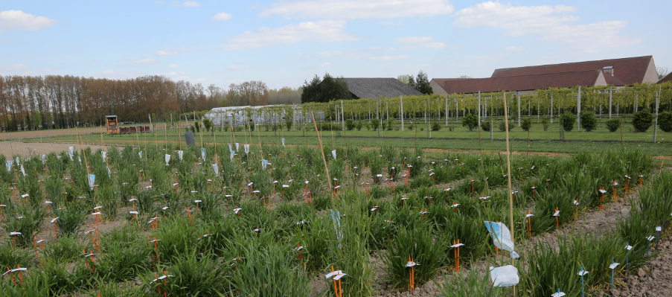
Proefhoeve Bottelare: een huis met vele kamers …
Onderwijs
  UGent: Bio-ingenieurs en master biowetenschappen (ind. Ing)
  HoGent: Professionele Bachelor in Agro- and Biotechnologie
Onderzoek/dienstverlening:
  VLAIO – FOD – EU – PWO-Landbouwcentra en demoprojecten – bilateraal
  met bedrijven - …
  Fundamenteel en praktijkonderzoek: from lab to field
  Core business: duurzaamheid - klimaatsverandering
    Teeltsystemen
    Gewasbescherming
    Planten genetica en –veredeling
    Precisie landbouw
    Biostimulanten
    Groenvoeder conservering
Internationaal en nationaal actief
Interactie met andere UGent/ HoGent labs en instituten:
ILVO, Inagro, Mytox, BDB, ...

Slide 8
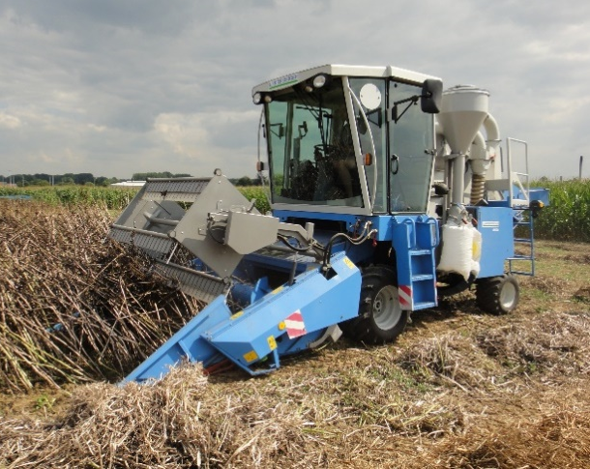
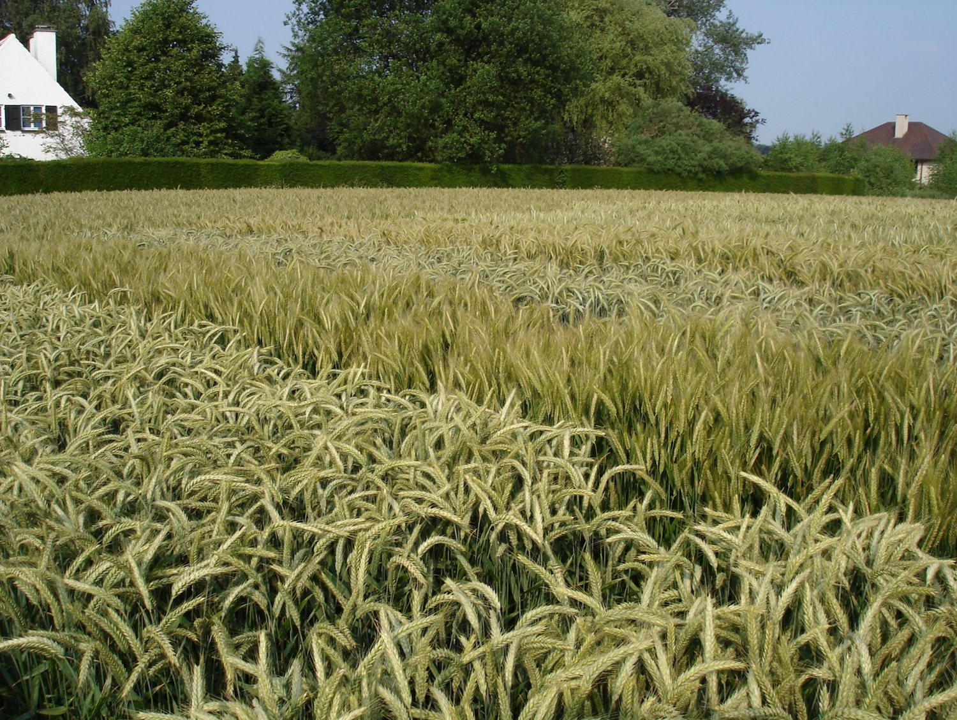
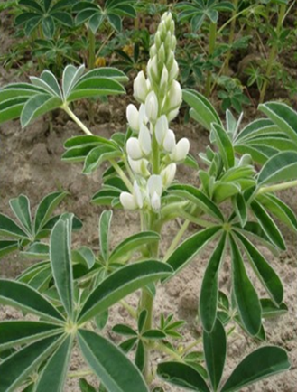
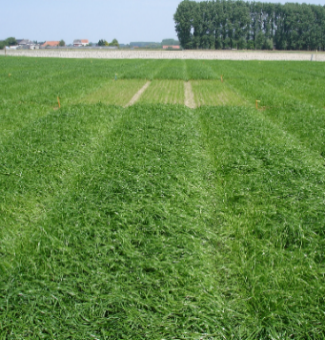
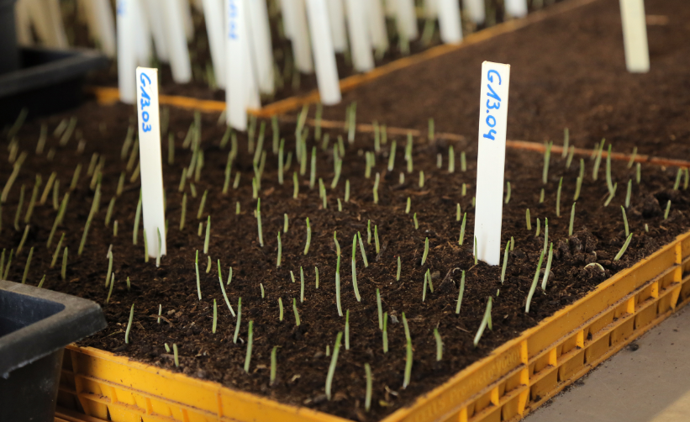
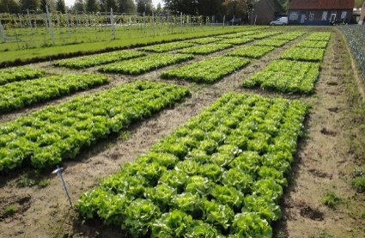
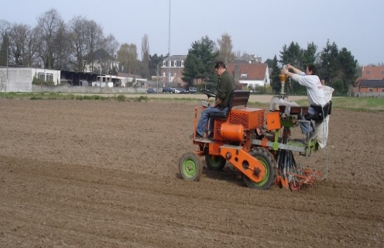
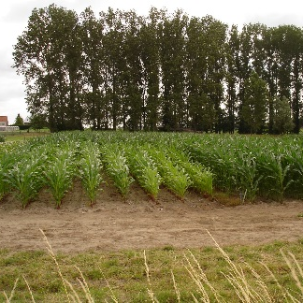
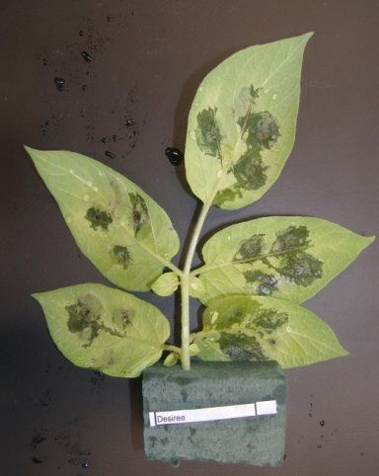
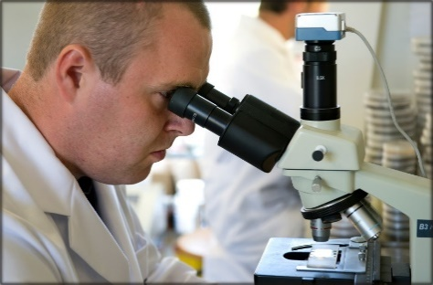
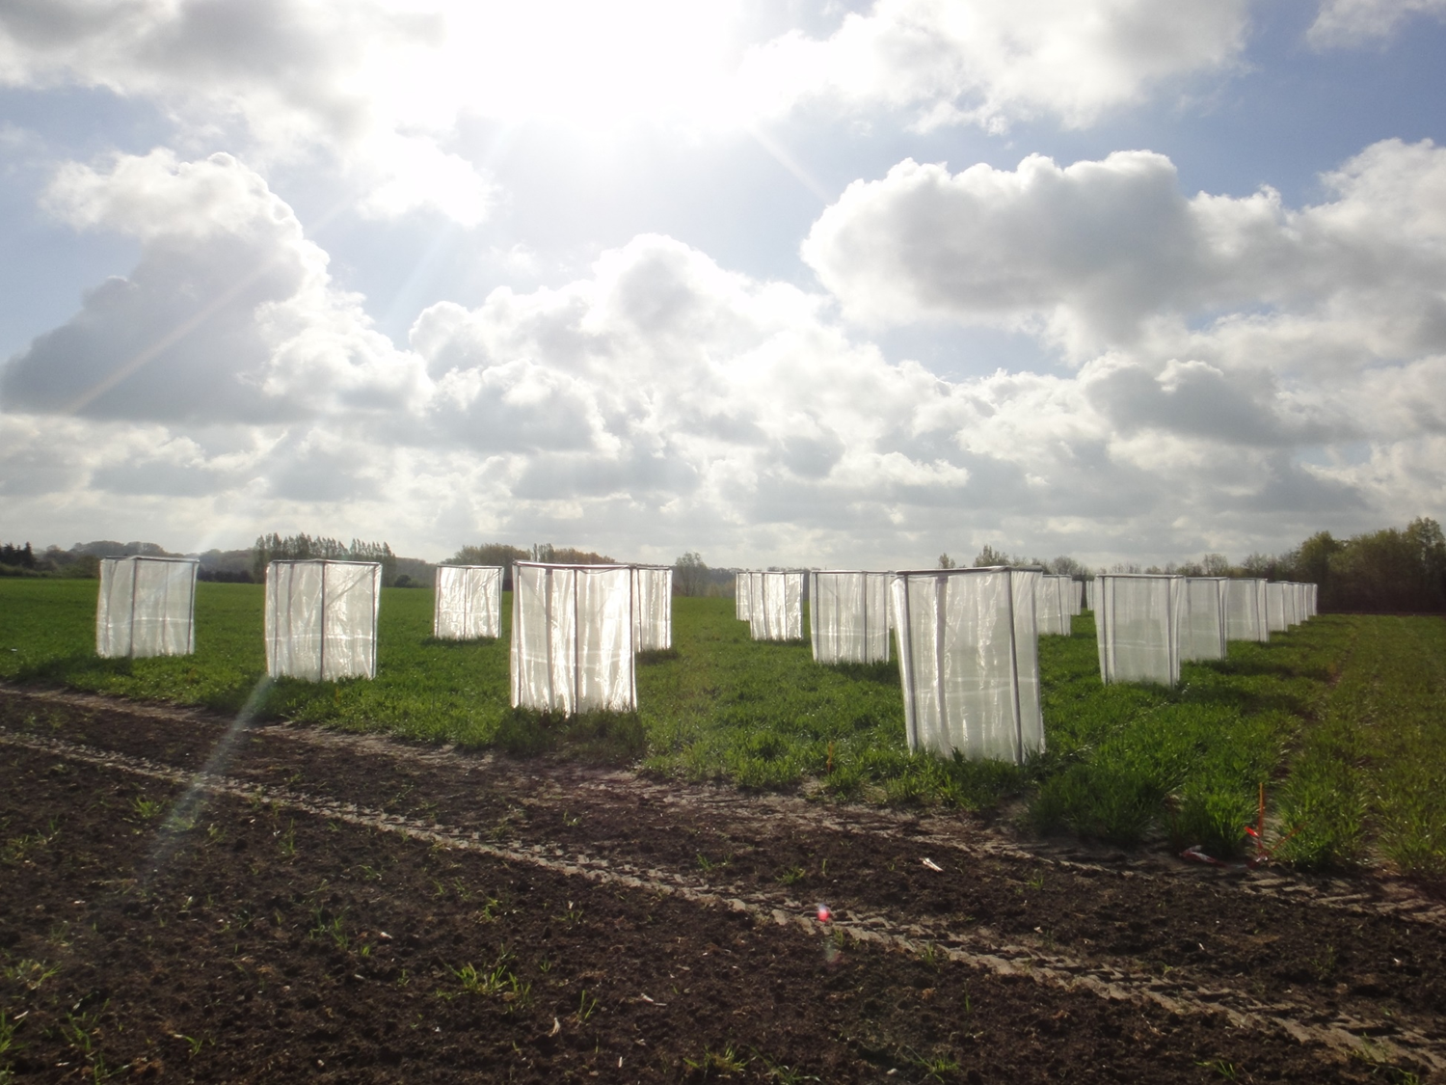
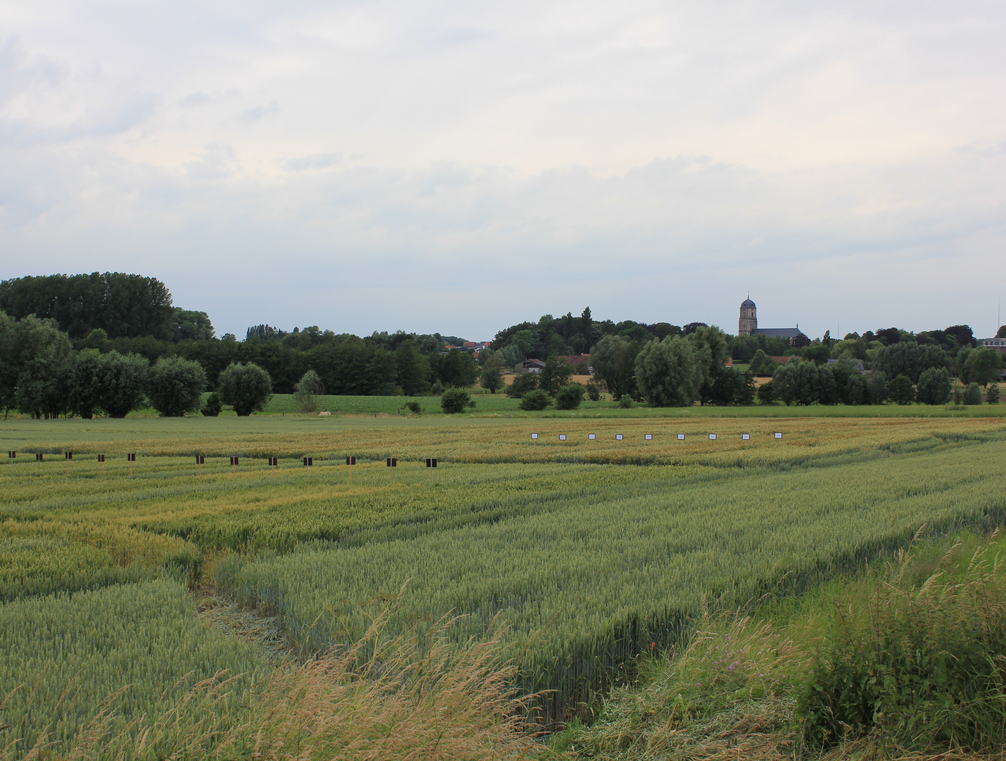
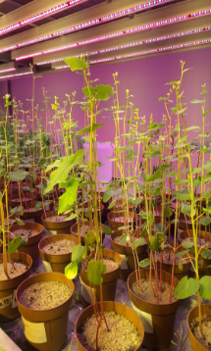
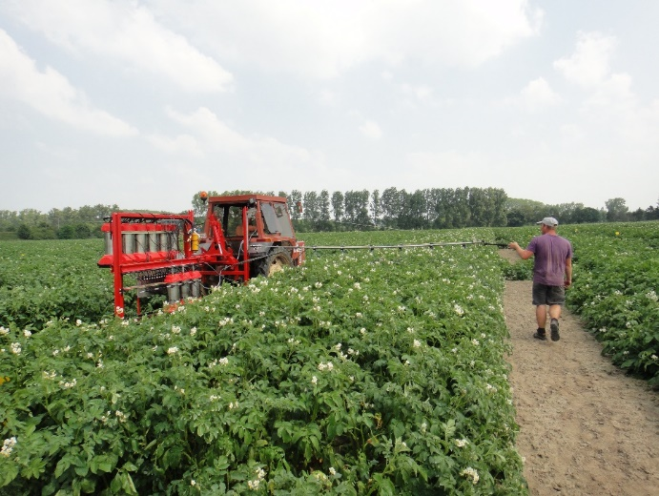
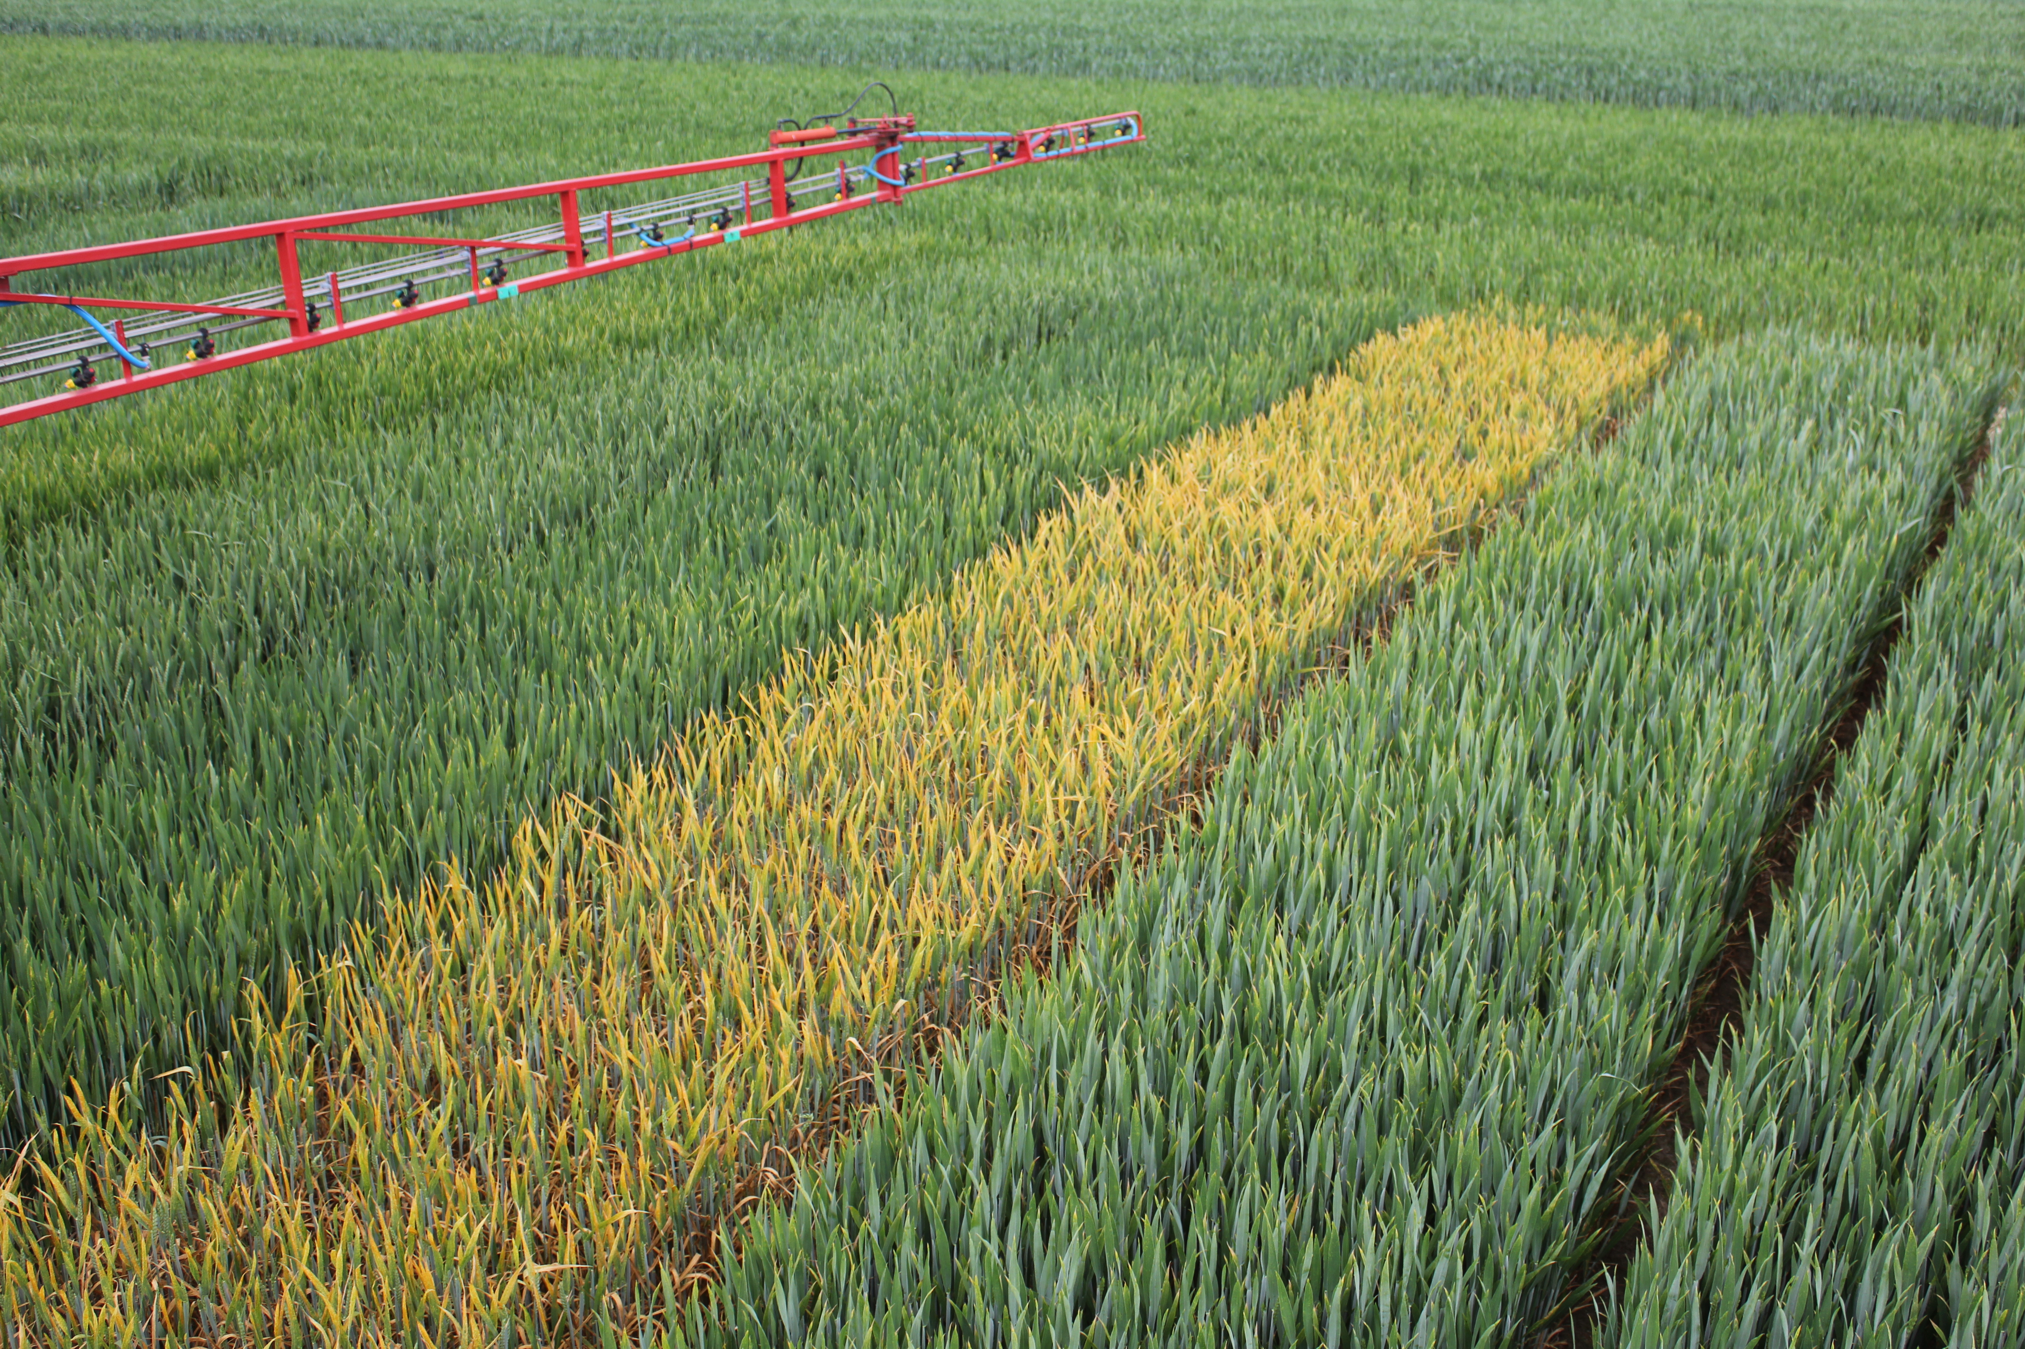
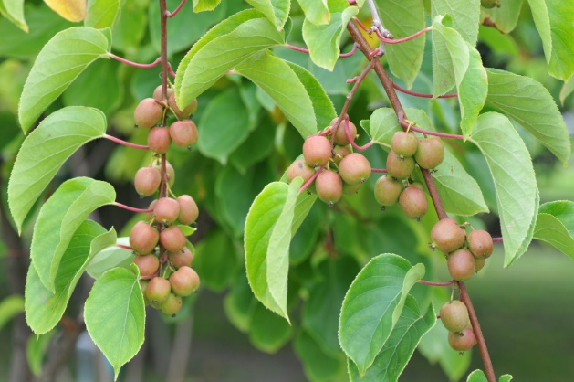
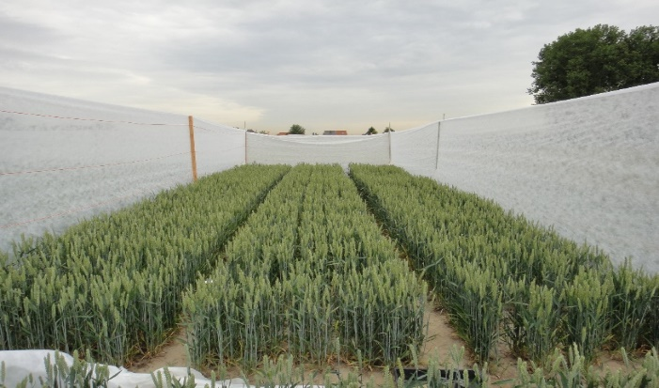
Project voorbeelden

Slide 9
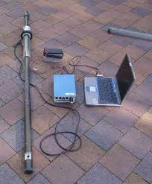
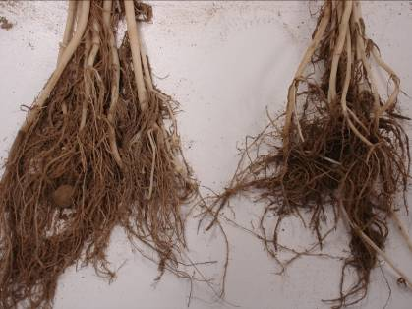
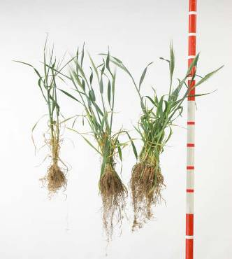
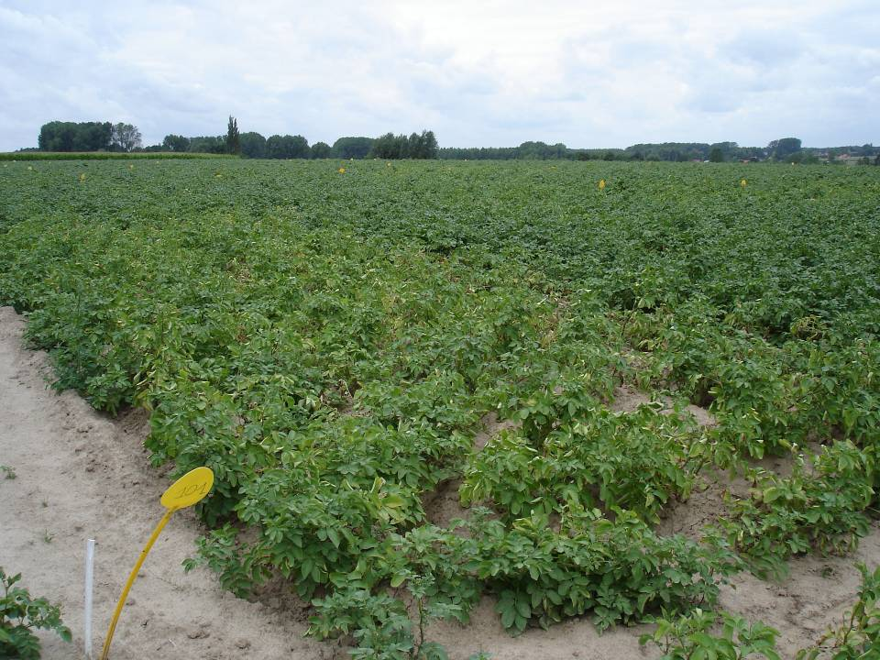
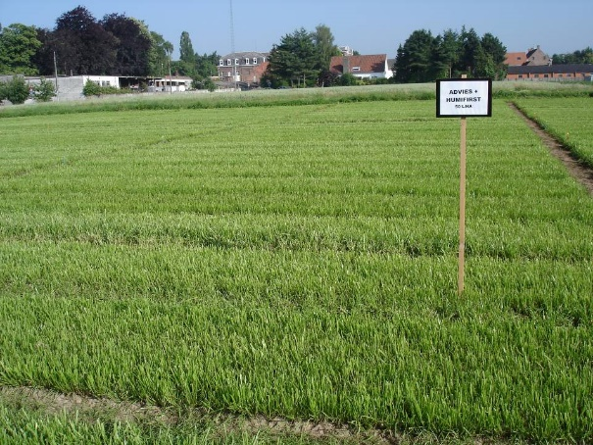
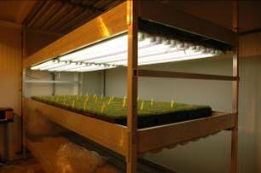
Duurzame intensifiëring: ontwikkeling van biostimulanten voor betere wortelgroei en nutriëntenopname
Humuszuur
Controle
Minirhizotrons
Controle
Humifirst
0.5l/100kg
Humifirst
1l/100kg

Slide 10
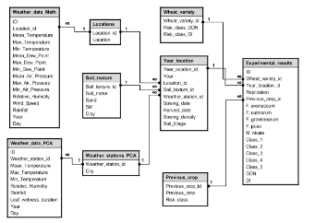
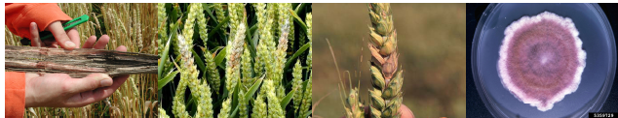
Geïntegreerde ziektebestrijding: predictie van plantenziekten
Aarfusarium tarwe: een probleem van mycotoxinen en voedselveiligheid
Model based on > 70 variables

Slide 11
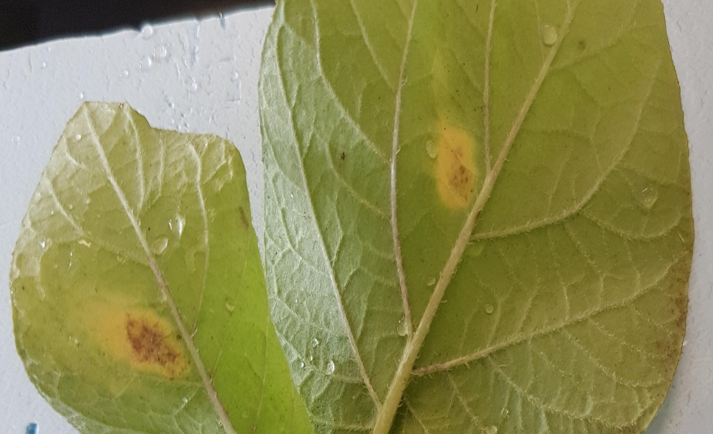
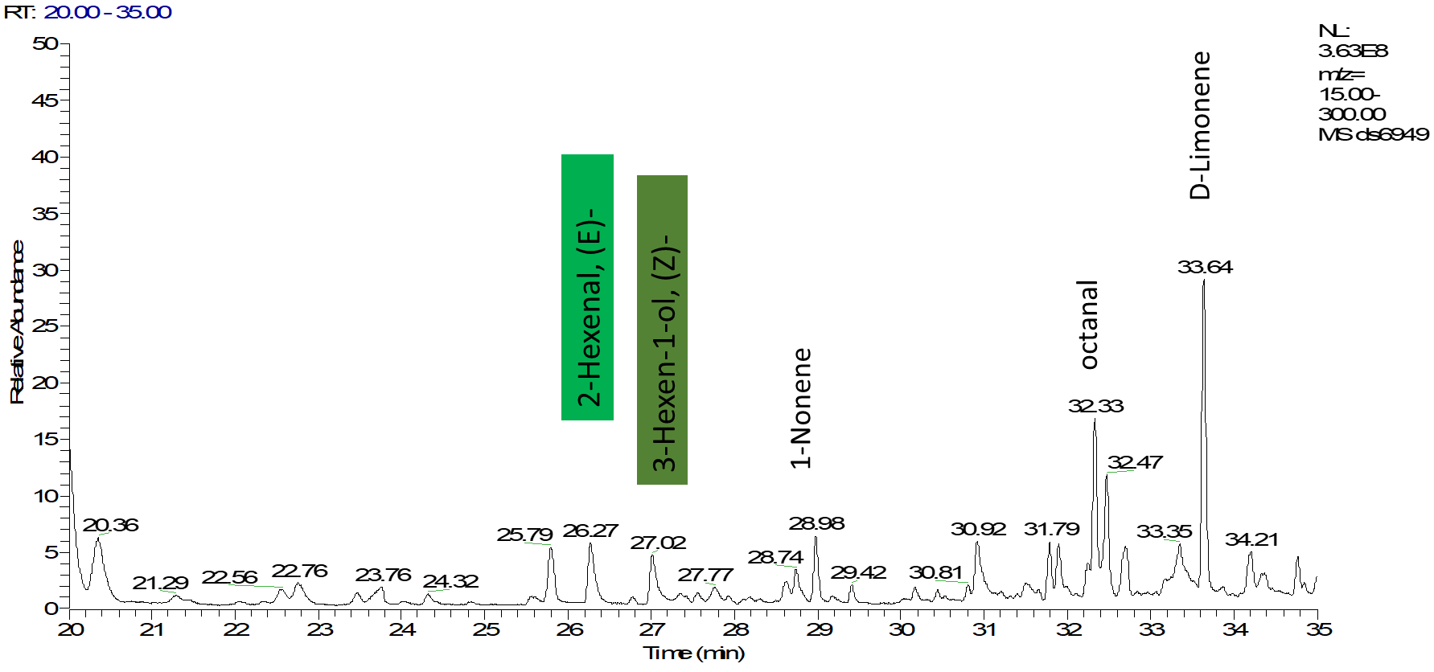
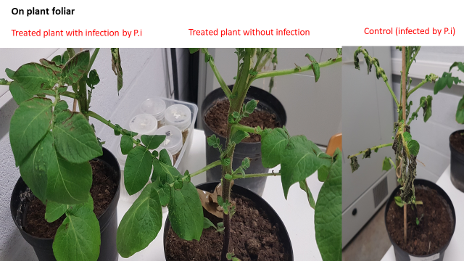
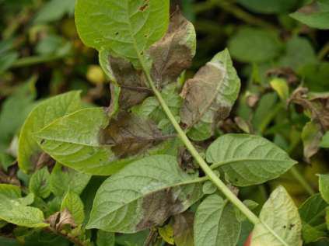
Een groen vaccin voor beheersing van de aardappelplaag

Slide 12
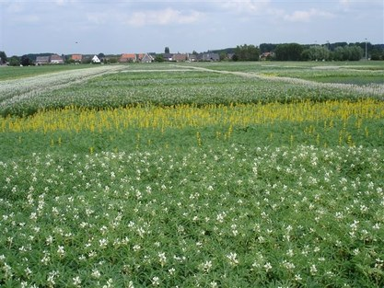
CROPDIVA: Climate Resilient Orphan croPs for increased DIVersity in Agriculture
28 partners
Eiwitgewassen, minder uitgezaaide granen (haver, triticale en boekweit) en mengteelten staan centraal
UGent Coördineert

Slide 13


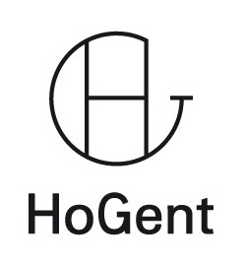
IOF consortium: from lab to field to fork
> 8 patenten
> 15 samenwerkingen met Vlaamse bedrijven
Excellentie centrum
35 professoren + 150 onderzoekers
Business Developer &
Innovation Officer
Est. 2016
Overdracht van kennis en technologie
Duurzame landbouw

Slide 14
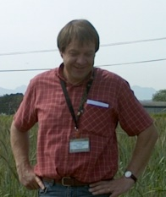



Geert Haesaert
Full professor
Plants and crops
E geert.haesaert@ugent.be
T +32 9 243.24.78
M +32 475.29.44.77 www.ugent.be
Ghent University
@ugent
Ghent University

Slide 15





Multifunctional agricultural robotics for significant agronomy and environmental benefits
department of environment
  research group precision scoring
Abdul M. Mouazen, 08/09/2021

Slide 16
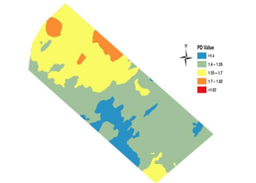
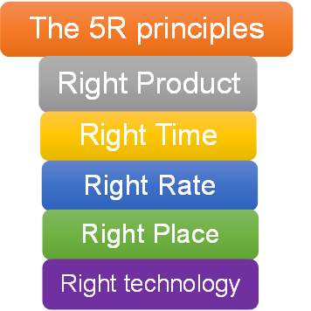

Context – precision agriculture
Problem:
Currently farming inputs are applied homogeneously over the entire area of a field:
Environmental contamination from excess use of agrochemicals.
Poor crop performance and yield.
Poor economic return.
Solution:
Variable rate application of farming inputs

Slide 17
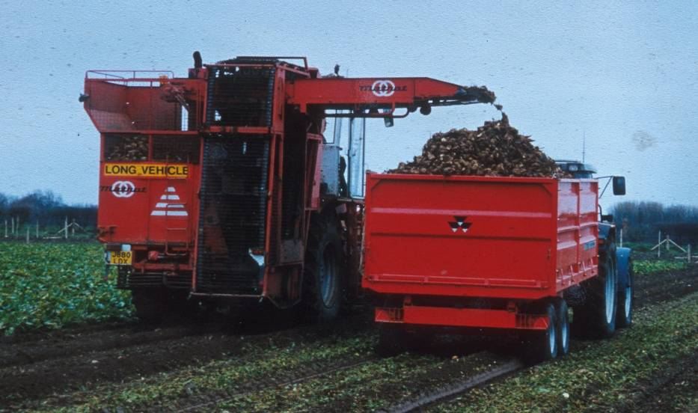
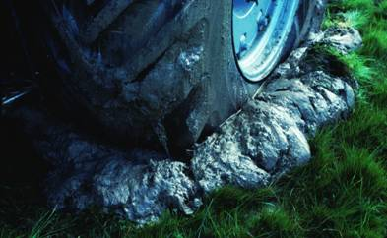
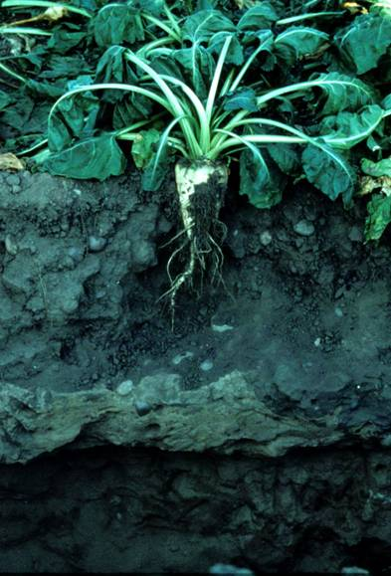
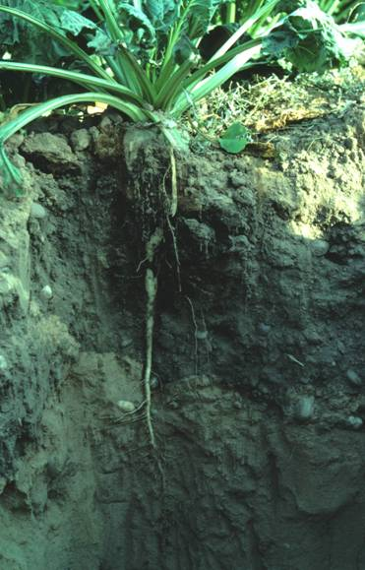
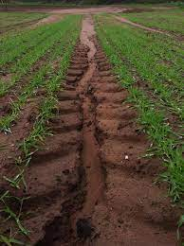
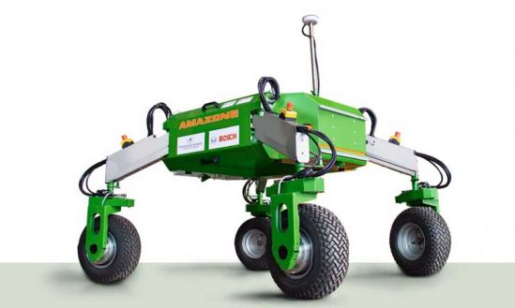
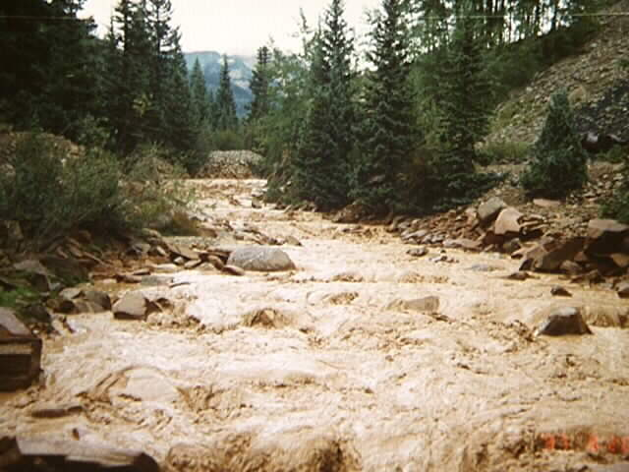
Context - robotics
Problem:
Heavy machines 30 – 70 t Compaction
Solution:
Light weight fleet of robots
Poor crop performance Erosion & Flooding

Slide 18
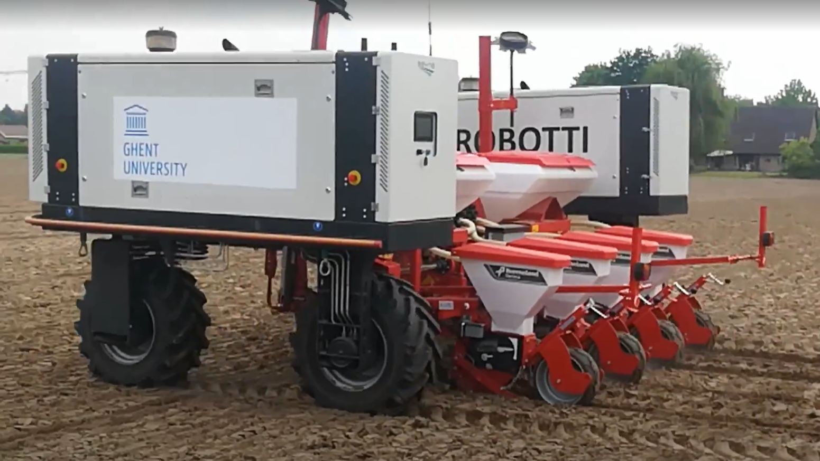
UGEnt solution
Combining Robotics + Precision application of farming inputs

Slide 19
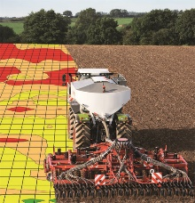
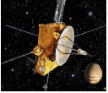

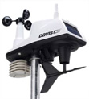


Integration of technologies
Integrated agricultural system:
Technologies to be integrated are often include:
Global positioning system (GPS)
Proximal soil and crop sensing
Remote sensing ‘of crop’
Auxiliary data (weather, topography)
Yield monitoring
Geographical information system (GIS)
Geostatistical modelling and mapping
Decision support tool (PA software)
Variable rate technologies.
GIS

Slide 20




Innovative multi-sensor platforms
High resolution data (1500 – 2000 readings per ha).
Any depth between 5 – 50 cm.
Can be fit onto different soil equipment e.g., tillage, planters & seeding machine.
Particularly successful for organic carbon, moisture, total nitrogen, clay and organic matter.
Less accurate for pH, P, K, Mg, and cation exchange capacity.
Lenses
Quartz
On-line multi-sensor platform (Mouazen, 2006)
Mouazen, A.M. (2006). Soil Survey Device. International publication published under the patent cooperation treaty (PCT). World Intellectual Property Organization, International Bureau. International Publication Number: WO2006/015463; PCT/BE2005/000129; IPC: G01N21/00; G01N21/00.

Slide 21


Cost-benefit analysis of site specific n fertilization
TREATMENT comparison | GROSS BENEFIT €/ha
Projected net benefit to farmer per ha per year (innovative IVR-UR) | 50-60
Projected net benefit to farmer per ha per year (innovative IVR-TVR) | 30
UR – Uniform rate
TVR – Traditional variable rate (NDVI)
IVR – Innovative variable rate (on-line soil data & NDVI)
€ 88 per ha extra profit to farmer for N, P and lime
FarmingTruth – ESA – Unpublished data

Slide 22
Environmental Analyses of N fertilisation
Impact | Receptor | Unit indicator | Cost |  | Annual non-market benefit per sensor
 |  |  | Value | Unit
Climate change impact | Atmosphere | CO₂e | 63,69792 | € t⁻¹ | 108,5413
 |  | N₂O |  | € t⁻¹
Air quality regulation | Atmosphere | NH₃ | 2,122898 | € t⁻¹ | 12,70115
Environmental water quality regulation | Rivers, canals | NO₃-N | 197,6832 | € t⁻¹ | 16,38464
 | Freshwater lakes | P |  | € t⁻¹
 | Transitional water | NO₃-N | 10,9824 | € t⁻¹ | 910,441
Drinking water regulation | Drinking water | NO₃-N | 210,8621 | € t⁻¹ | 17,47629
Total benefit per sensor per year |  |  |  |  | 156,0138
Assumptions:
1 soil sensor measures about 6800 ha per year
Figures are for N fertilisation only
FarmingTruth – ESA – Unpublished data

Slide 23

Economic and environmental benefits for Site specific manure application
TREAT | AREA (ha) | Manure (t/ha) | COST PER HECTARE (EUR) | YIELD (t/ha) | Output (EUR) | PROFIT PER HECTARE (EUR) | COMPARISON PER HECTARE (EUR) | PROFIT PER TREATMENT (EUR) | SIMULATION PROFIT PER FIELD (EUR)
UR | 3.40 | 35 | -16.50 | 12.52 | 1903.04 | 1919.54 | ------ | 6523.55 | 18392.29
Kings VR1 | 3.14 | 36.9 | -13.24 | 12.81 | 1946.36 | 1959.60 | 40.06 | 6156.83 | 18776.14
R. Hood VR2 | 3.04 | 32.52 | -23.94 | 12.71 | 1931.92 | 1955.86 | 36.32 | 5948.24 | 18740.32
Yield 1.5 – 2.3 %
Profit 1.9 – 2.1 %
TREAT | Area (Ha) | Total N per entire area (kg/ha) | N applied (kg/ha) | Comparison (kg/ha) | Simulated N Kg / field | Comparison simulated N (kg/field) |  | Total P per entire area (Kg/ha) | P applied (Kg/ha) | Comparison (kg/ha) | Simulated P Kg / field | Comparison simulated P (kg/field)
UR | 3.40 | 983.87 | 289.50 |  | 2773.88 |  |  | 178.42 | 52.50 |  | 503.03
Kings VR1 | 3.14 | 925.96 | 294.71 | 5.21 | 2823.84 | 49.96 |  | 170.07 | 54.13 | 1.63 | 518.65 | 15.61
R. Hood VR2 | 3.04 | 844.22 | 277.59 | -11.91 | 2659.78 | -114.09 |  | 148.35 | 48.78 | -3.72 | 467.38 | -35.65
Kings N 1.8 %
P 3.1 %
R. Hood N - 4.1 %
P - 7.1 %

Slide 24
cost-benefits analysis for Site specific potato seeding
Treatment | Cost (€/ha) | Yield (t/ha) | Revenue (€/ha) | Net Profit (€/ha) | Relative profit (€/ha)
UR | 2200 | 31.06 | 6728 | 4528 | -
Vis-NIR | 2186 | 31.89 | 7181 | 4995 | 467
EMI | 2205 | 32.42 | 7152 | 4947 | 419
Yield 2.62% Cost 0.6%
Profitability 10.32%

Slide 25
conclusions
Need for advanced sensing technologies + multi-sensor data fusion.
Integrated solution of robotics and precision application of farming inputs.
Significant increase in profitability, and reduction in environmental impacts and waste.

Slide 26

Odysseus project overview
Sponsor: FWO
Coordinator: Prof. Abdul Mouazen
Budget: 3.5 M EUR
Duration: 5 years starting in January 2017
Title: Towards Setting up a Centre of Site-specific Technology for Soil and Crop Management (SiTeMan)
Aim: To establish a research platform combining cutting-edge soil and crop sensors, modelling and system control technology for managing farm resources site-specifically. The overall targets are maximizing crop yield, whilst minimizing input cost, environmental impacts and waste.

Slide 27



Abdul M. Mouazen
Full professor of Site Specific Soil and Crop management
Department of soil Environement
E abdul.mouazen@ugent.be
T +32 9 264 6037
M +32 484 7707 23 www.ugent.be
Ghent University
@ugent
Ghent University

